Slide 1
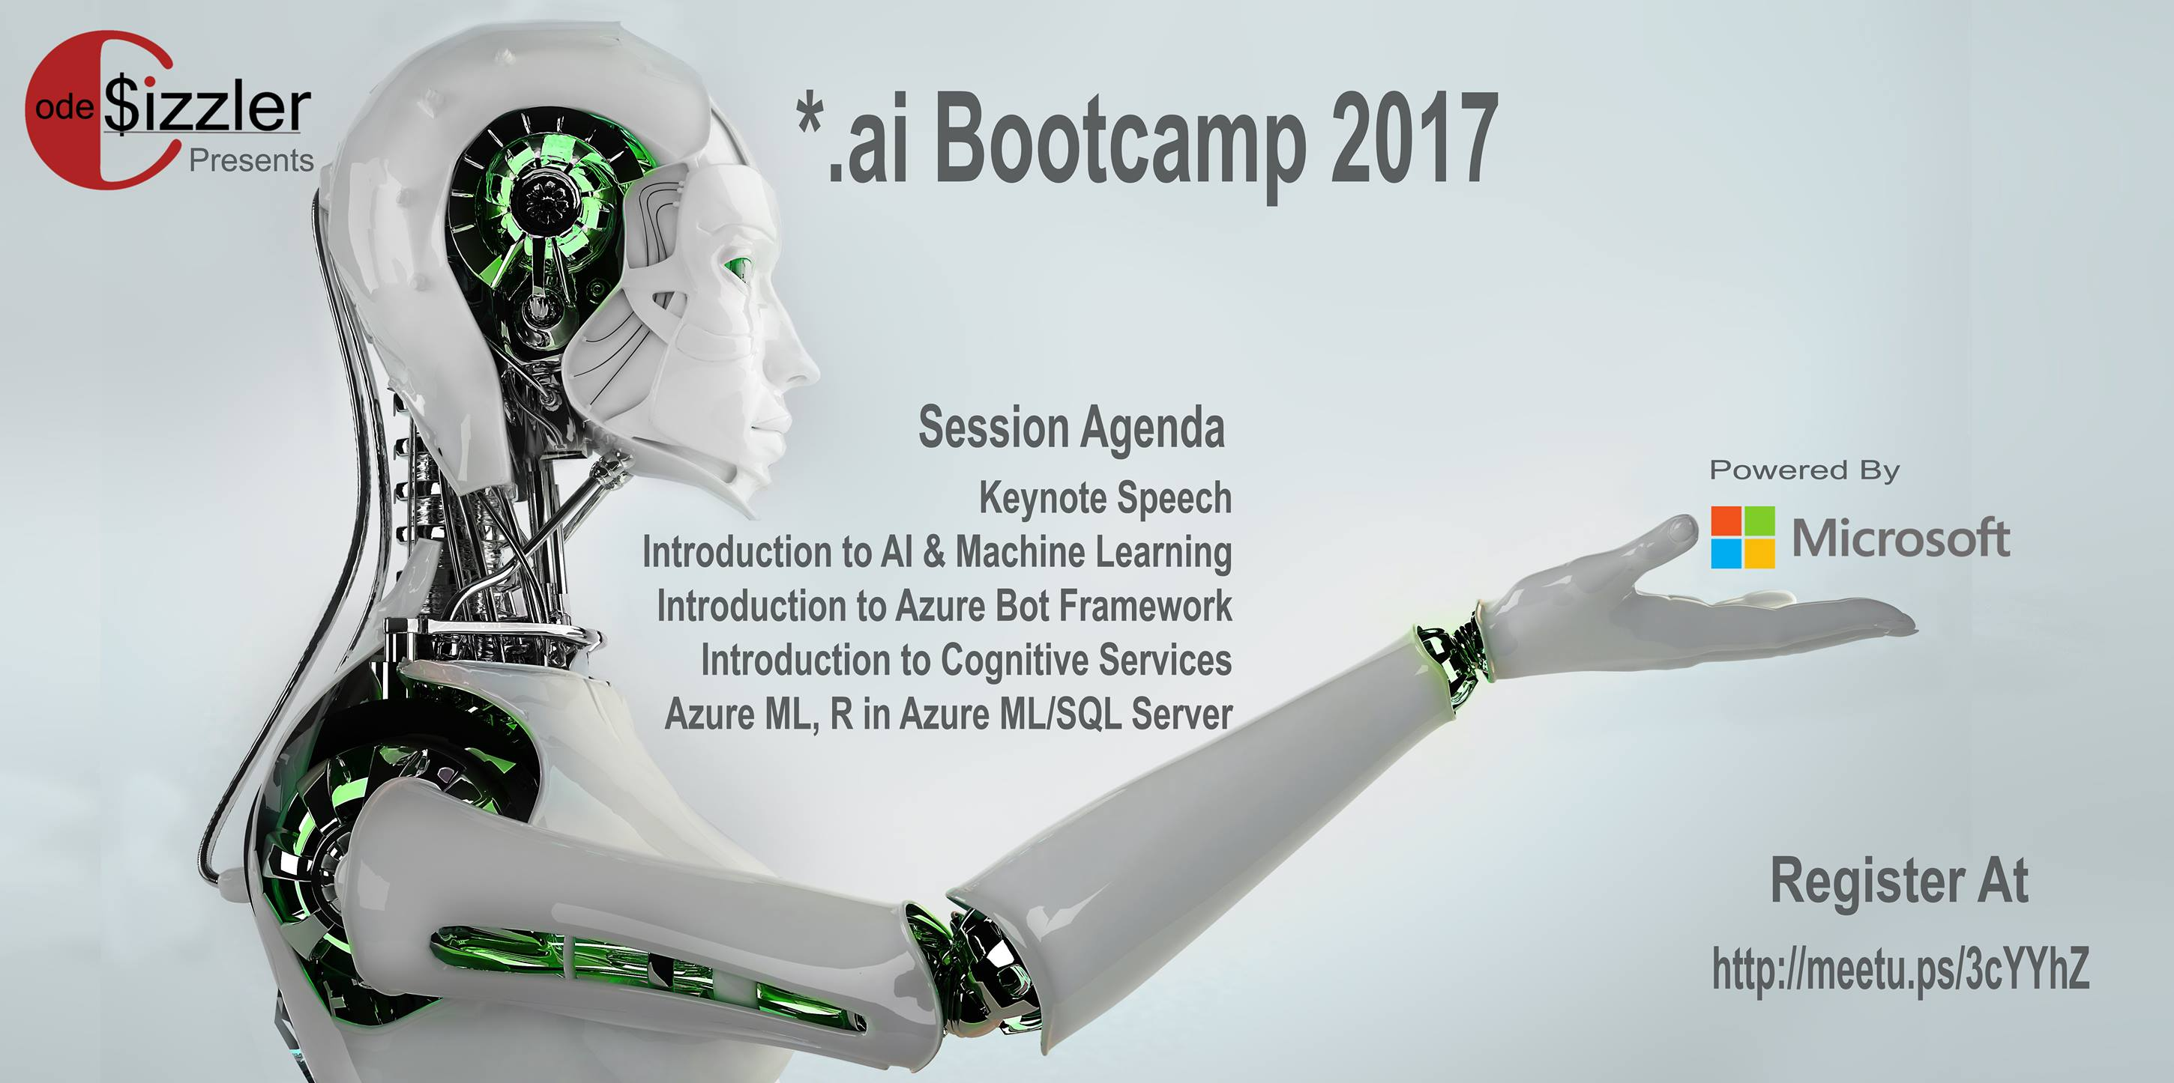
#CodeSizzler | #Microsoft | #ai , @TechFero | @CodeSizzler *.ai - Machine Learning with Azure

Slide 2
Introduction to Artificial Intelligence & Machine Learning
Abdul Rasheed Feroz Khan
Director / Founder – CodeSizzler
Microsoft Most Valuable Professional - Azure
#CodeSizzler | #Microsoft | #ai , @TechFero | @CodeSizzler

Slide 3

Abdul Rasheed Feroz Khan
Founder & Director – CodeSizzler
Microsoft MVP – Azure
7+ years of experience in Training
Azure – IoT – Machine Learning – Cognitive Services - Xamarin
#CodeSizzler | #Microsoft | #ai , @TechFero | @CodeSizzler *.ai - Machine Learning with Azure
#csharpconf2017, @TechFero
#csharpconf2017, @TechFero Machine Learning with Azure

Slide 4
Artificial Intelligence & Machine Learning
Introduction to Artificial Intelligence
Introduction to Machine Learning
Azure’s support on Machine Learning – ML Studio
#CodeSizzler | #Microsoft | #ai , @TechFero | @CodeSizzler *.ai - Machine Learning with Azure

Slide 5
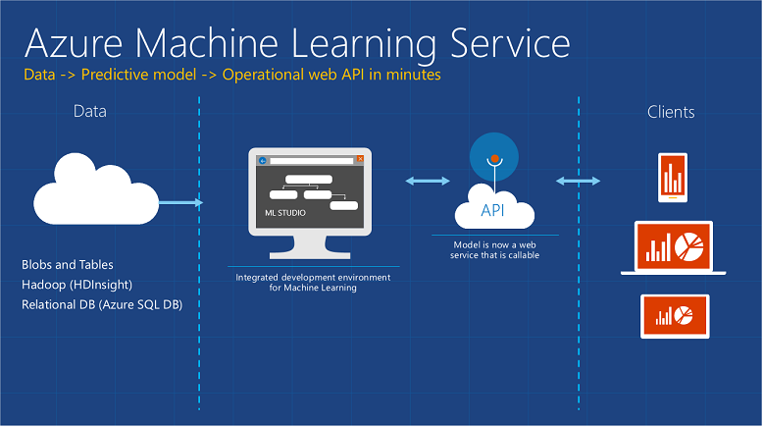
Source - https://blogs.technet.microsoft.com/machinelearning/2015/06/29/azure-machine-learning-for-engineers/
# CSharpCon17, @TechFero Machine Learning with Azure
#csharpconf2017, @TechFero

Slide 6
Machine Learning
Build a model
Train a model
Regression model & Classification model
#CodeSizzler | #Microsoft | #ai , @TechFero | @CodeSizzler *.ai - Machine Learning with Azure

Slide 7
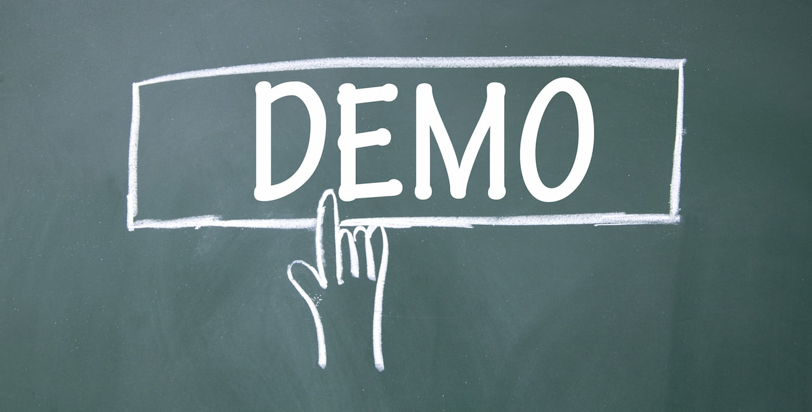
#CodeSizzler | #Microsoft | #ai , @TechFero | @CodeSizzler *.ai - Machine Learning with Azure

Slide 8
Links
http://bit.do/csharp17
https://studio.azureml.net/
https://github.com/codesizzler
#CodeSizzler | #Microsoft | #ai , @TechFero | @CodeSizzler *.ai - Machine Learning with Azure

Slide 9
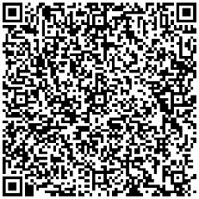
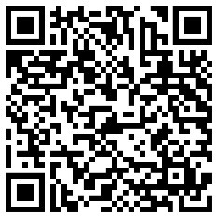
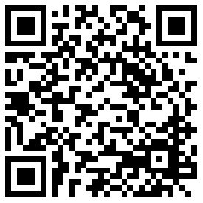
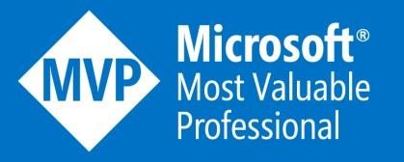


Reach me

